Slide 1
Aqueous Solutions and the Concept of pH
Chapter-6

Slide 2
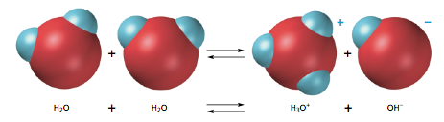
Self-Ionization of Water
Self-ionization of water: two water molecules produce a hydronium ion and a hydroxide ion by transfer of a proton

Slide 3
Self-Ionization of Water
Conductivity measurements show that the concentrations of H₃O⁺ and OH⁻ in pure water are each only 1.0 x 10⁻⁷ mol/L at 25° C.
Concentrations are denoted by brackets
[H₃O⁺] means “hydronium ion concentration in mol/L”
In water at 25° C,
[H₃O⁺] or [H⁺] = 1.0 x 10⁻⁷ M and [OH⁻] = 1.0 x 10⁻⁷ M
The mathematical product of [H⁺] and [OH⁻] remains constant in water and dilute aqueous solutions at constant temperature

Slide 4
Ionization Constant of Water
The constant mathematical product is called the ionization constant of water
Denoted by K_{w}
K_{w} = [H⁺] [OH⁻] (at 25° C)
K_{w} = (1.0 x 10⁻⁷ )(1.0 x 10⁻⁷ ) = 1.0 x 10⁻¹⁴
the ionization of water increases as temperature increases,
so K_{w} increases

Slide 5
Neutral, Acidic, and Basic Solutions
When [H⁺] = [OH⁻], the solution is neutral
When [H⁺] > [OH⁻], the solution is acidic
When [H⁺] < [OH⁻], the solution is basic
Math alert: a smaller negative exponent means a greater concentration

Slide 6
Calculations
Strong acids and strong bases completely dissociate so
The concentration of the base equals to [OH⁻]
The concentration of the acid equals to [H⁺]
What is the [H⁺] of a 7.5 x 10⁻⁵ M HCl solution?
[HCl] = [H⁺] because HCl is a strong acid
[H⁺] = 7.5 x 10⁻⁵ M

Slide 7
Practice
What is the [OH⁻] of the solution on the HCl solution at 25°C?
K_{w} = [OH⁻] [H⁺]
[OH⁻] = K_{w} / [H⁺]
[OH⁻] = 1.0 x 10⁻¹⁴ / 7.5 x 10⁻⁵
[OH⁻] = 1.3 x 10⁻¹⁰ M

Slide 8
More Practice
A 1.5 x 10⁻² M NaOH solution is prepared at 25°C. Calculate the [OH⁻] and [H⁺]
Determine if the solution is basic, acidic, or neutral and justify your answer.
[OH⁻] = 1.5 x 10⁻² M
[H⁺] = 6.7 x 10⁻¹³ M
[OH⁻] > [H₃O⁺] so the solution is basic

Slide 9
The pH Scale
pH stands for two French words “pouvoir hydrogène” meaning “hydrogen power”
pH : The negative of the common logarithm of the hydrogen ion [H⁺] concentration of a solution.
pH = -log [H⁺]
pOH : The negative of the common logarithm of the hydroxide ion [OH⁻] concentration of a solution.
pOH = -log [OH⁻]
pH + pOH = 14

Slide 10
Acids and bases
Acids have a lot of Hydrogen ions (H⁺) and bases have a lot of Hydroxide ions (-OH).
A solution is neutral if its pH equals seven.
More acidic
More basic
H⁺
H⁺
H⁺
Neutral
H⁺
H⁺
⁻OH
H⁺
⁻OH
H⁺
⁻OH
⁻OH
⁻OH
H⁺
H⁺
H⁺
H⁺
H⁺
⁻OH
⁻OH
H⁺
⁻OH
⁻OH
H⁺
H⁺
H⁺
(H⁺) + (⁻OH) =
H₂O
⁻OH
⁻OH
⁻OH
H⁺
H⁺
H⁺
⁻OH
H⁺
H⁺
⁻OH
H⁺
H⁺
⁻OH
H⁺
⁻OH
⁻OH
H⁺

Slide 11
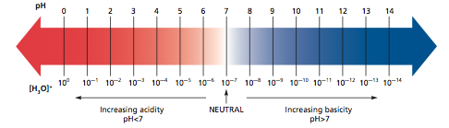
The pH Scale

Slide 12
Calculations
pH = -log [H⁺]
A neutral solution at 25°C, pH = -log 1.0 x10⁻⁷ = 7.0
If a solution has [H⁺] = 3.4 x 10⁻⁴, How much pH?
pH = -log [H⁺]
then pH = -log 3.4 x 10⁻⁴
= 3.47
So if you know the hydrogen ion concentration, you can easily calculate the pH

Slide 13

Importance of pH in the natural world
Excess Carbon Dioxide production as a result of burning fossil fuels increases the amount of acid rain in the atmosphere. When this rain comes down it kills trees and fish by changing the pH values of their habitat.
This affects humans indirectly by limiting the amount of oxygen that can be recycled back into the atmosphere and in our dependency on fish as food or fish meal.

Slide 14
pH Facts
Item | pH
Human Blood | 7.41
Ocean Water | 8.2
Acid Rain | < 5.6
Milk | ~ 6.4
Beer | 4-5
Vinegar | ~ 3
Bottled/Distilled water | ~ 4.5

Slide 15
Question
How can pH affect you? Write your answer in your note book in complete sentences. Explain your answers.

Slide 16
pOH
pOH
The negative of the common logarithm of the hydroxide ion concentration [OH⁻]
“p” means take the negative log
pOH = -log [OH⁻]
Relationships at 25°
pH + pOH = 14.0
pH + pOH = pK_{w}
pH of an acidic solution is less than 7, while the pOH is greater than 7
pH of a basic solution is greater than 7, while the pOH is less than 7

Slide 17
pH problem
1. The hydrogen-ion concentration of a solution is 2.7 x 10⁻¹⁰ mol/L. What is the pH of the solution.
Answer
pH = -log[2.7 x 10⁻¹⁰]
pH = 9.6
2. The pH of a solution is 6.8. What is the [H⁺]?
Answer
6.8 = -log [H⁺]
-6.8 = log [H⁺]
10^{x} (-6.8) = log [H⁺] 10^{x}
1.6 x 10⁻⁷ mol/L = [H⁺]

Slide 18
pH problem 3
What is the pH of a solution if the [OH⁻] = 4.0 x 10⁻¹¹ mol/L
Answer
[H⁺] x 4.0 x 10⁻¹¹ mol/L = 1.0 x 10⁻¹⁴ M²
[H⁺] = 2.5 x 10⁻⁴ mol/L
pH = -log(2.5 x 10⁻⁴ mol/L)
pH = 3.6

Slide 19
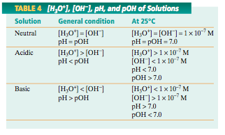
Summary

Slide 20
Calculating Concentrations from pH and pOH
pH = -log [H⁺]
[H⁺] = 10^{-pH}
What is the [H⁺] of a solution with a pH of 2.34? (4.57 x 10⁻³ M)
[OH⁻] = 10^{-pOH}
What is the [OH⁻] of a solution with a pOH of 12.56? (2.75 x 10⁻¹³ M)
What is the [OH⁻] of a solution with a pH of 6.54? (3.47 x 10⁻⁸ M)

Slide 21
Buffer
Buffered solution: a solution that can resist changes in pH when an acid or a base is added to it; a buffer
If a small amount of a strong acid is added, the extra H⁺ ions cause a shift to the left in the equilibrium and the pH is changed very little

Slide 22
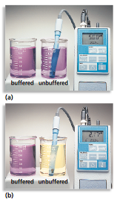
If a small amount of a strong base is added, the extra OH⁻ reacts with water, causes a shift to the right in the equilibrium, and the pH is changed very little

Slide 23
Preparation of a Buffer
Solution of a weak acid and a salt of the weak acid
Solution of a weak base and a salt of the weak base
Add a little strong base to an excess of weak acid
Add a little strong acid to an excess of weak base

Slide 24
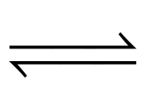
Buffer Action in the Blood
Human blood needs to maintain a pH of 7.3-7.5
Enzymes only function over a particular pH range
Because of the following buffer, blood's pH is fairly steady:
CO_{2(aq)} + H₂O_{(l)} H⁺_{(aq)} + HCO₃⁻_{(aq)}

